Slide 1

CampusLoop
Campus Lost and Found Management System
Presented by
M. Mokshitha - 24KB105AC
U. Guru Nikitha - 24KB1A05LV
K. Leelavathi - 24KB1A05T8
M. Hasini - 24KB1A05Z8
III BTECH |CSE - D | NBKR INSTITUTE OF SCIENCE AND TECHNOLOGY
Notes:
Introduce the project and the team. Replace the name and roll number placeholders in the table.

Slide 2




Introduction
Students sometimes lose their belongings on campus.
Finding them is hard when there is no common place to report them.
Report.
Search.
Recover.
CampusLoop is a web application to report and find lost items.
It provides a single platform to manage lost and found items.
Notes:
Explain in your own words how students lose things on campus and why a single platform helps.

Slide 3




Problem Statement
Scattered information
Lost-item news spreads through word of mouth and separate groups.
No common place
Students may not know where to check for missing belongings.
Hard to verify
It is difficult to confirm an item belongs to the person claiming it.
One system helps
A common system makes the whole process easier.
Notes:
Today information is scattered across groups and word of mouth. A common system fixes that.

Slide 4
Objectives
1
Provide a common platform for lost and found items
2
Let users report lost or found belongings with full details
3
Make it easy to search and filter reported items
4
Update an item's status once it has been recovered
5
Keep all item details organized in a database
Notes:
Walk through the five objectives briefly.

Slide 5






Technologies Used
FRONTEND
BACKEND
DATABASE
React JS
Node.js and Express JS
TiDB Cloud
Creates the user interface.
Handles server operations.
MySQL-compatible database. Stores user and report details.
IMAGE STORAGE
COMMUNICATION
DEPLOYMENT
Cloudinary
REST APIs
GitHub Pages and Render
Stores uploaded item images.
Connects frontend and backend.
Hosts the frontend and backend.
Notes:
Frontend: React JS. Backend: Node.js with Express JS. Database: TiDB Cloud (MySQL-compatible). Images are stored in Cloudinary. REST APIs connect the frontend and backend. The frontend is hosted on GitHub Pages and the backend on Render.

Slide 6
Key Features
Student registration and login.
Separate admin login.
Report lost and found items with images.
Browse, search, and filter reports.
View complete details of reported items.
Admin can mark items as returned or delete reports.
Images are stored using Cloudinary.
Notes:
Walk through the key features: student and admin logins, reporting with images, browsing and searching, and admin tools to mark items as returned or delete reports.

Slide 7
Working of the Project
1
2
3
4
5
6
Login
Report
Store
Browse
Manage
Recover
Students register and log in to the application.
Students submit lost or found item details with an image.
Report information is stored in TiDB Cloud, and images are uploaded to Cloudinary.
Students can search, filter, and view available reports.
Admin can manage reports and update their status.
Once an item is returned, its status is updated.
Notes:
Walk through the flow: students log in, report an item with an image, details go to TiDB Cloud and the image to Cloudinary, students browse and search, the admin manages reports, and the status is updated once the item is returned.

Slide 8

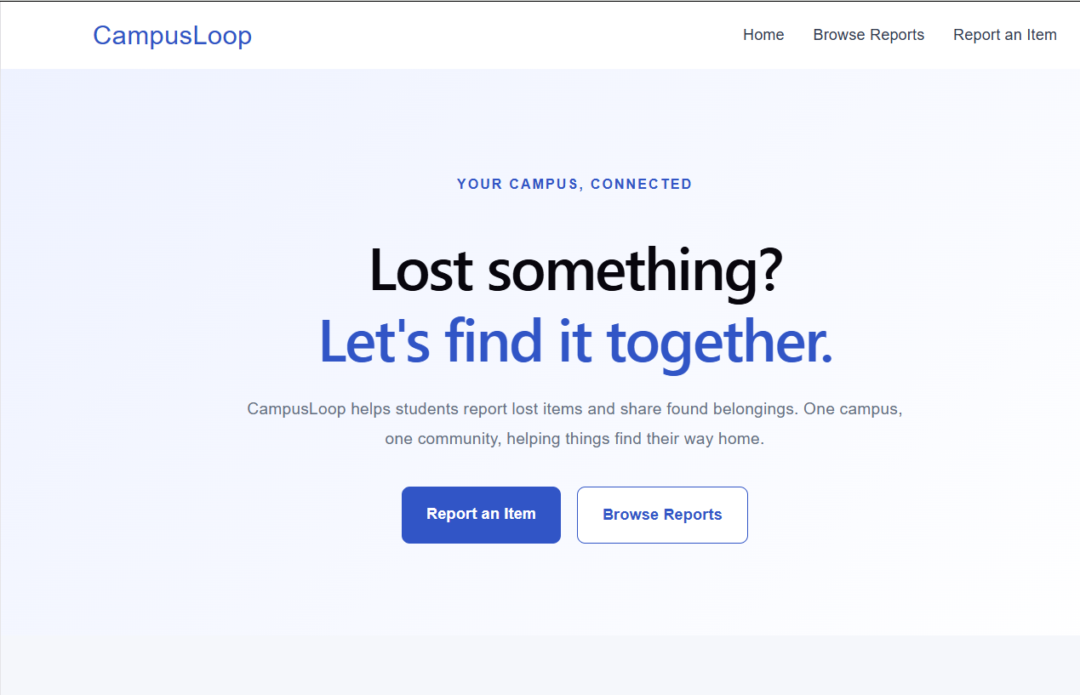

Expected Outcome
A common platform for managing lost and found items.
Easy reporting and searching of belongings.
Image-based identification of reported items.
Organized storage of report and user information.
Better management of recovered items.
Notes:
Add a screenshot of your running application in the placeholder box.

Slide 9
Conclusion
CampusLoop provides a simple and organized way to manage lost and found items within a college campus. It allows students to report and search for belongings while providing administrators with tools to manage reports. By using React JS, Node.js, Express JS, TiDB Cloud, and Cloudinary, the project brings these activities together in one web application.
Thank You
Notes:
Summarise and thank the faculty.

